Slide 1
A machine learning information retrieval approach to protein fold recognition
Jianlin Cheng and Pierre Baldi
Bioinformatics, vol. 22, no. 12, pp. 1456-1463, 2006.
Speaker: Chun-Jen Chen
Date: Apr. 29, 2009

Slide 2
Abstract
Motivation: Recognizing proteins that have similar tertiary structure is the key step of template-based protein structure prediction methods. Traditionally, a variety of alignment methods are used to identify similar folds, based on sequence similarity and sequence-structure compatibility. Although these methods are complementary, their integration has not been thoroughly exploited. Statistical machine learning methods provide tools for integrating multiple features, but so far these methods have been used primarily for protein and fold classification, rather than addressing the retrieval problem of fold recognition-finding a proper template for a given query protein.
115/11/07

Slide 3
Abstract
Results: Here we present a two-stage machine learning, information retrieval, approach to fold recognition. First, we use alignment methods to derive pairwise similarity features for query-template protein pairs. We also use global profile–profile alignments in combination with predicted secondary structure, relative solvent accessibility, contact map and beta-strand pairing to extract pairwise structural compatibility features. Second, we apply support vector machines to these features to predict the structural relevance (i.e. in the same fold or not) of the query-template pairs.
115/11/07

Slide 4
Abstract
For each query, the continuous relevance scores are used to rank the templates. The FOLDpro approach is modular, scalable and effective. Compared with 11 other fold recognition methods, FOLDpro yields the best results in almost all standard categories on a comprehensive benchmark dataset. Using predictions of the top-ranked template, the sensitivity is ~85, 56, and 27% at the family, superfamily and fold levels respectively. Using the 5 top-ranked templates, the sensitivity increases to 90, 70, and 48%.
115/11/07

Slide 5
Introduction
The key step of template-based protein structure prediction approaches is to recognize proteins that have similar tertiary structures. This task becomes very challenging when there is little sequence similarity between the query and the template protein.
we propose a machine learning information retrieval approach that leverages features extracted using existing, general-purpose, alignment tools as well as protein structure prediction program and combines them using support vector machines (SVMs) to rank all the templates.

Slide 6
Classical approaches to fold recognition
Sequence – Sequence
  effective at detecting homologs with significant sequence identity (>40%).
Sequence – Profile
  more sensitive at detecting distant homologs with lower sequence identity (>20%).
Profile – Profile
  even more sensitive at detecting distant homologs and compatible structures
Sequence – Structure
  align query sequences with template structures and compute compatibility scores according to structural environment fitness and contact potentials.

Slide 7
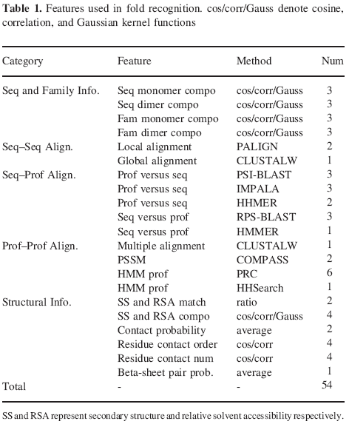

Slide 8
Method
Template
各種不同的Align方法
各種方法的Score
當Feature
SVM
Final score
Rank all templates

Slide 9
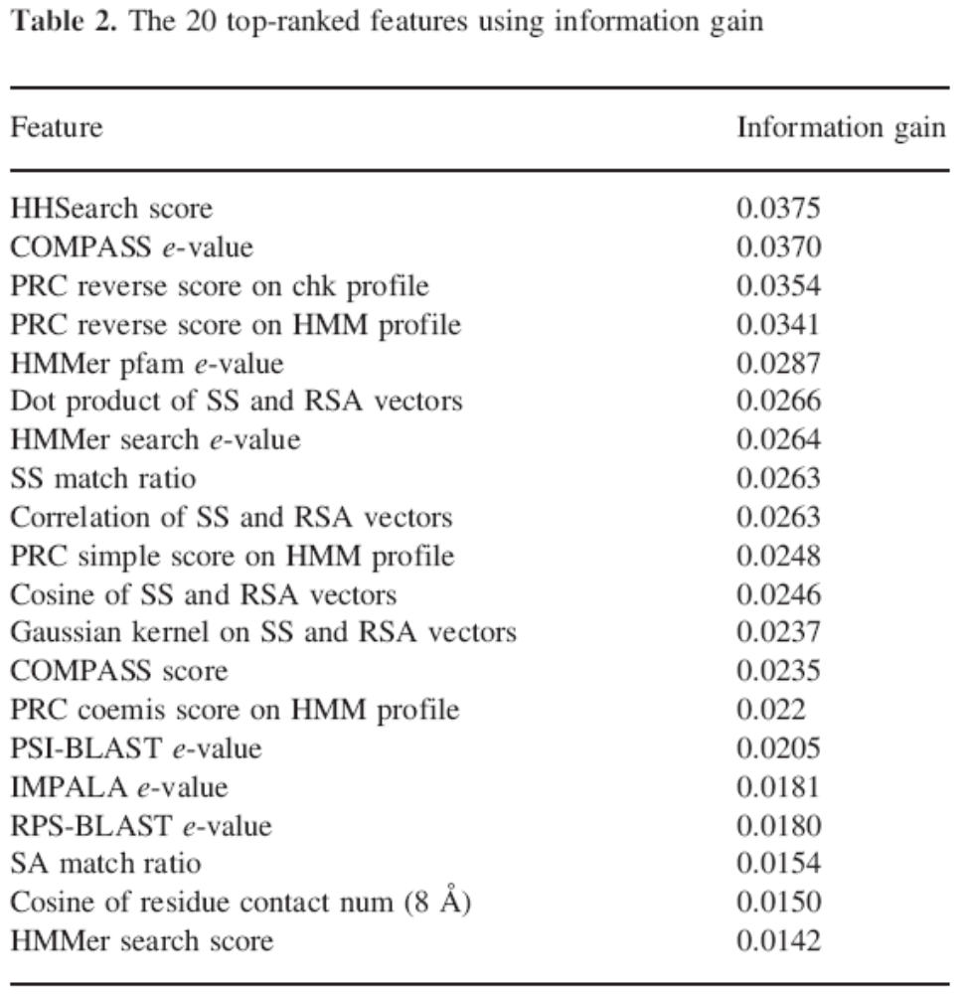

Slide 10
we use the large benchmark dataset (Lindahl and Elofsson, 2000) derived from the SCOP (Structural Classification of Proteins, Murzin et al., 1995) database. The Lindahl’s dataset includes 976 proteins. The pairwise sequence identity is <= 40%. We extract a feature vector for all 976 x 975 distinct pairs.
We split all protein pairs evenly into 10 subsets for 10-fold cross validation purposes. All the query–template pairs associated with the same query protein are put into the same subset. Nine subsets are used for training and the remaining subset is used for validation. The pairs in the training dataset that use queries in the test dataset as templates are removed.

Slide 11
